Slide 1
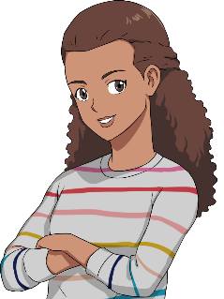

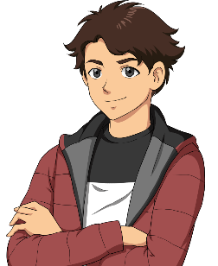
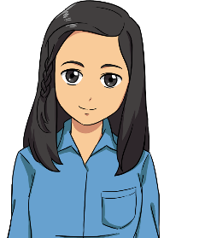

Example slide 3
Monash Bootcamp 2021 – Project 1
Collaboratively Designed & Built
By
Dylan, Luis B, Sharon, Viv

Slide 2








Intro slide 1
Concept
Hey, team why don’t we build an app that does a market scan of popular games online AND give us the sale price.
Cool idea!
I’m a “Gamer”
There’s limited apps that conduct a market comparison.
Gaming is huge, everyone wants a good deal!!
Wow! Can we actually build that?
It’s achievable!
First let’s do some research and a market scan.
Notes:
Description
Motivation for Dev

Slide 3

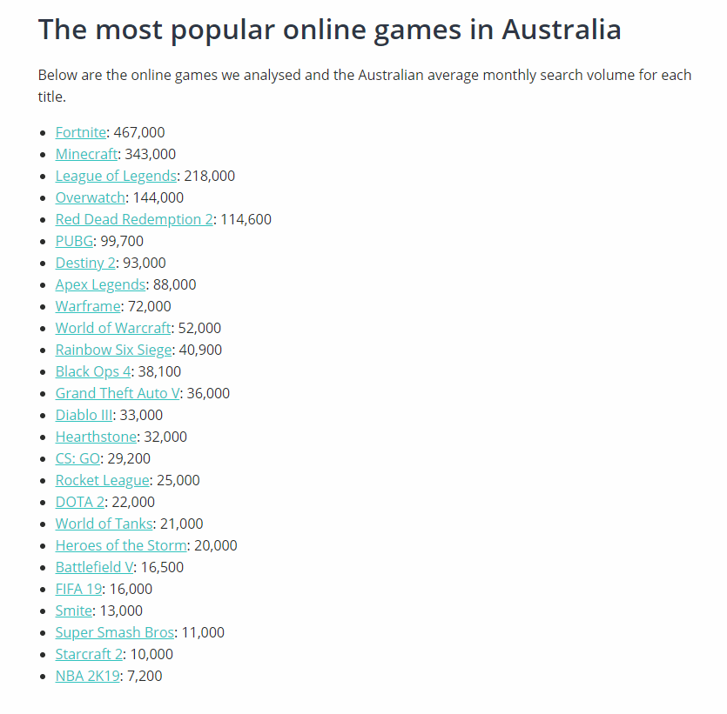
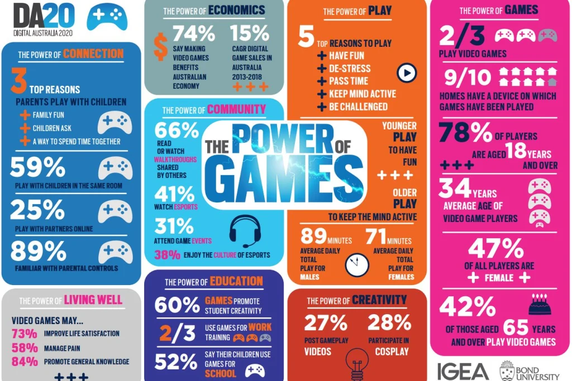
Intro slide 2
Elevator Pitch
Hold up!
There’s market demand.
Check out the monthly search volume on games! It’s huge!!
Market Scan Facts
78% “Gamers” in Australia are 18 yrs. +
Average age is 34
91% households have a gaming device
Average playtime = 89 mins (males) 71 mins (females)

Slide 4





Intro slide 3
Technology
Guys, what Technology can we use?
I know we learnt API and fetch…
Fetch…throwing a ball to my dog…that’s about all I remember!
RAWG
Fetch RAWG API
RAWG API Response
Fetch Cheap Shark API
Cheap
Shark
RAWG API Response
Dude…two API calls should cut it.
We’ll use
RAWG to get popular games & Cheap Shark to get the sale price

Slide 5


Example slide 1
Breakdown of Tasks & Roles
API Analysis – All
Concept & Mock Design – All
HTML & CSS – Viv & Luis
JavaScript – Sharon & Dylan
USER STORY
As a GAMER
I WANT to know most popular games
SO THAT I can determine the sale price.

Slide 6

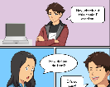



Intro slide 3
Guys HELP somethings up with merge of GITHub files
Challenges
GitHub Merge Conflicts
API render of data - images
Time – never enough time ☺
Can one of you call the TA’s to help. Strahinja must be over me calling him.
S&I%! what’s happened to the CSS layout.

Slide 7


Example slide 3
Finally! It’s working.
AND it’s only 9.29 pm the night before its due
Successes
Gaming App
GitHub Knowledge
API – Fetch Knowledge
Team Collaboration & Friendships
Woo Hoo!

Slide 8

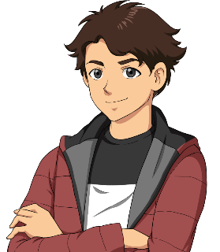


Intro slide 1
Demonstration
https://vvnnzar.github.io/Game-App/
I’m so old.
I still play Monopoly.
Hope the class loves it.
100,000
Can’t wait to purchase that game now I’ve seen it on our app!

Slide 9



Intro slide 2
I’ve got some ideas for improvement
Wouldn’t it be cool to have a list of vendors
Need to fix that issue
Future Development
.
We can take this to the next level.
Search Capability
Market price listing & vendor navigation
Game movie previews
Game rating capability
CSS image scaling
Refinement of code
.

Slide 10


Example slide 2
Questions & Feedback
.
I’ve got a Question
https://vvnnzar.github.io/Game-App/
Project Links
.
https://github.com/vvnnzar.

